Slide 1

reputation! reputation! reputation!
Semeion Research Center for the Science of Communication
Reputation! Reputation! Reputation! Workshop 11-13 December 2013
G e o f f r e y M O N A G H A N

Slide 2
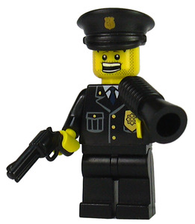
lego police
Reputation! Reputation! Reputation! Workshop 11-13 December 2013
G e o f f r e y M O N A G H A N

Slide 3
britain
Can the Police be Trusted? Probably not
October 21, 2013 Raymond Peytors - theopinionsite.org
Reputation! Reputation! Reputation! Workshop 11-13 December 2013
G e o f f r e y M O N A G H A N

Slide 4
australia
Racist police can’t be trusted with Tasers
November 2010 Solidarity.net.au
Reputation! Reputation! Reputation! Workshop 11-13 December 2013
G e o f f r e y M O N A G H A N

Slide 5
united states of america
Why the police lie under oath
2 February 2013 Michelle Alexander New York Times, Sunday Review
Reputation! Reputation! Reputation! Workshop 11-13 December 2013
G e o f f r e y M O N A G H A N

Slide 6
G e o f f r e y M o n a g h a n

