Slide 1
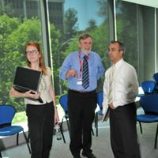
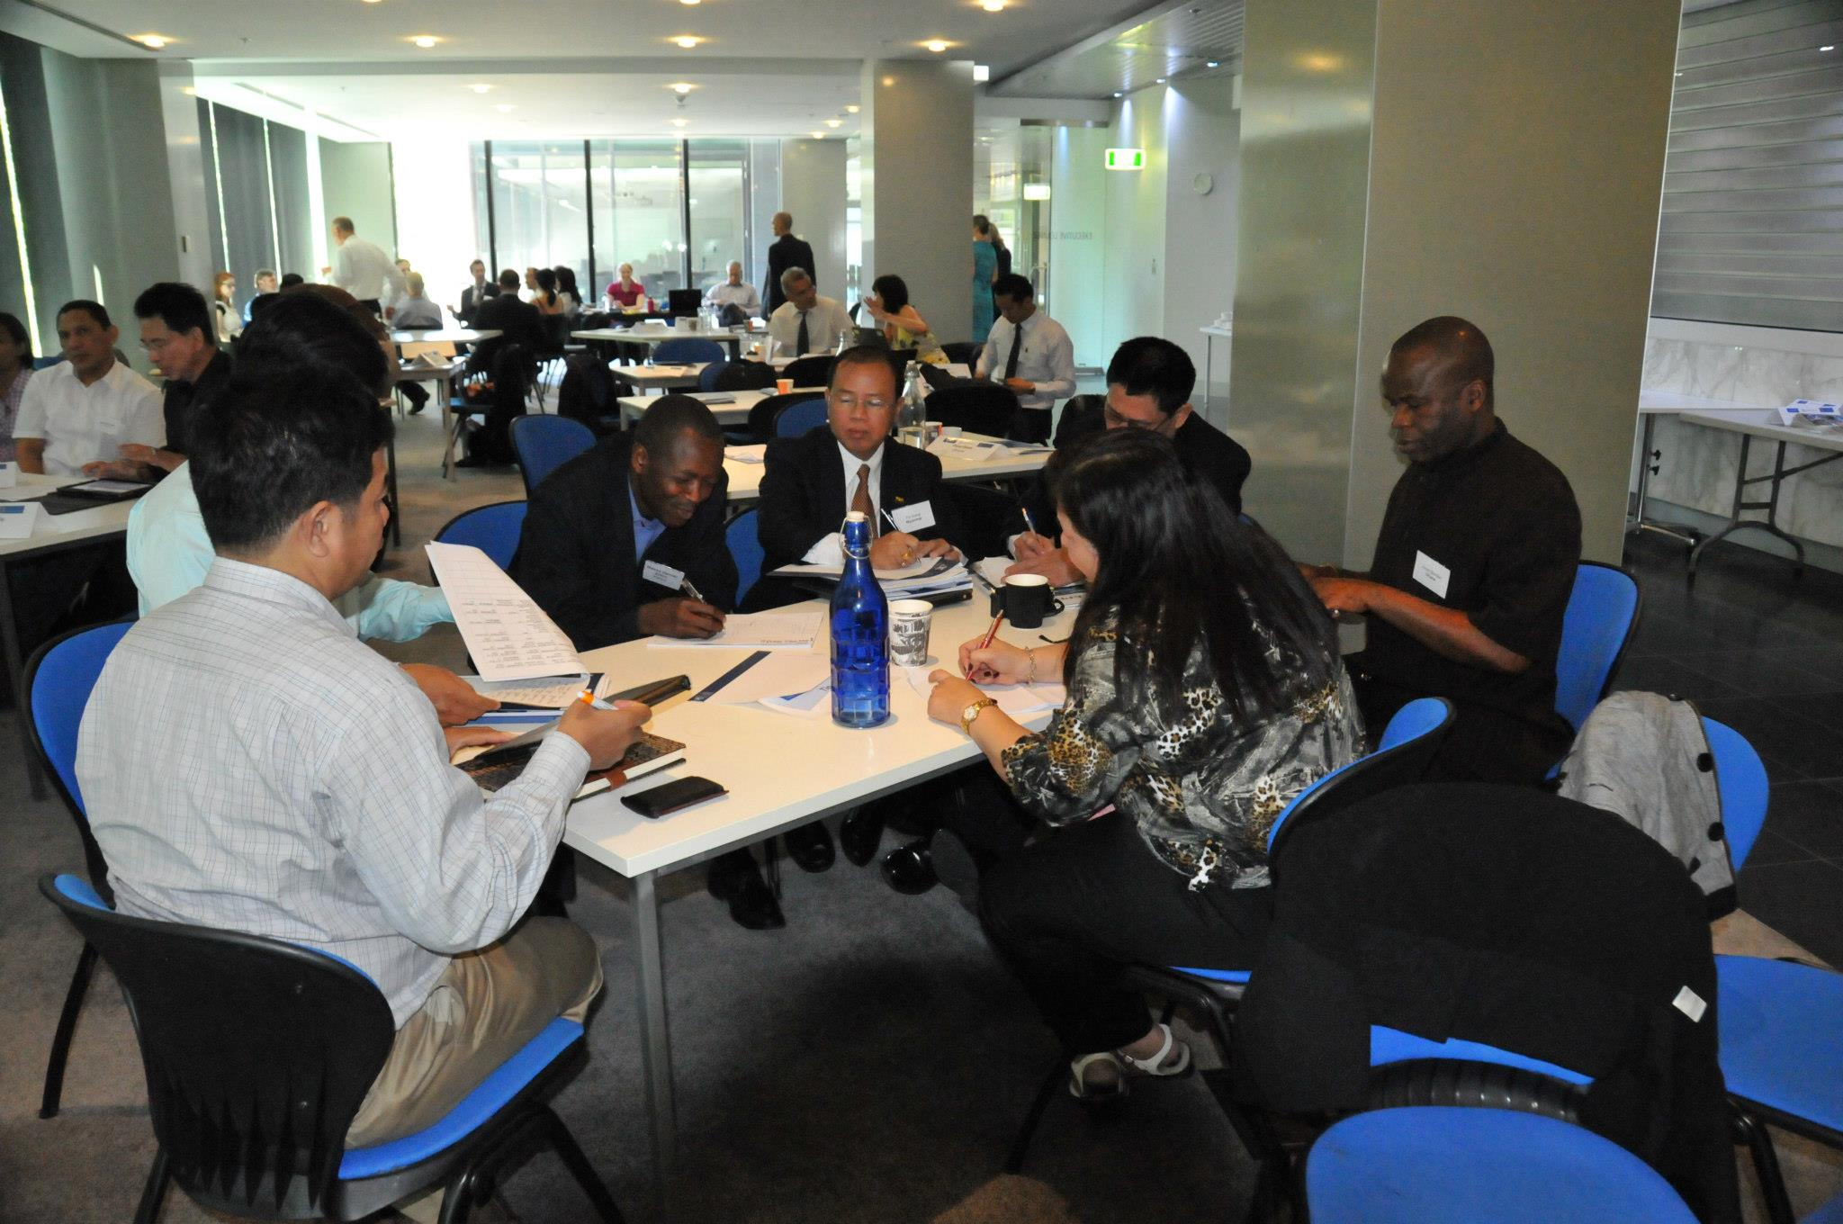
LEAHN Consultation 2012 Melbourne
.

Slide 2
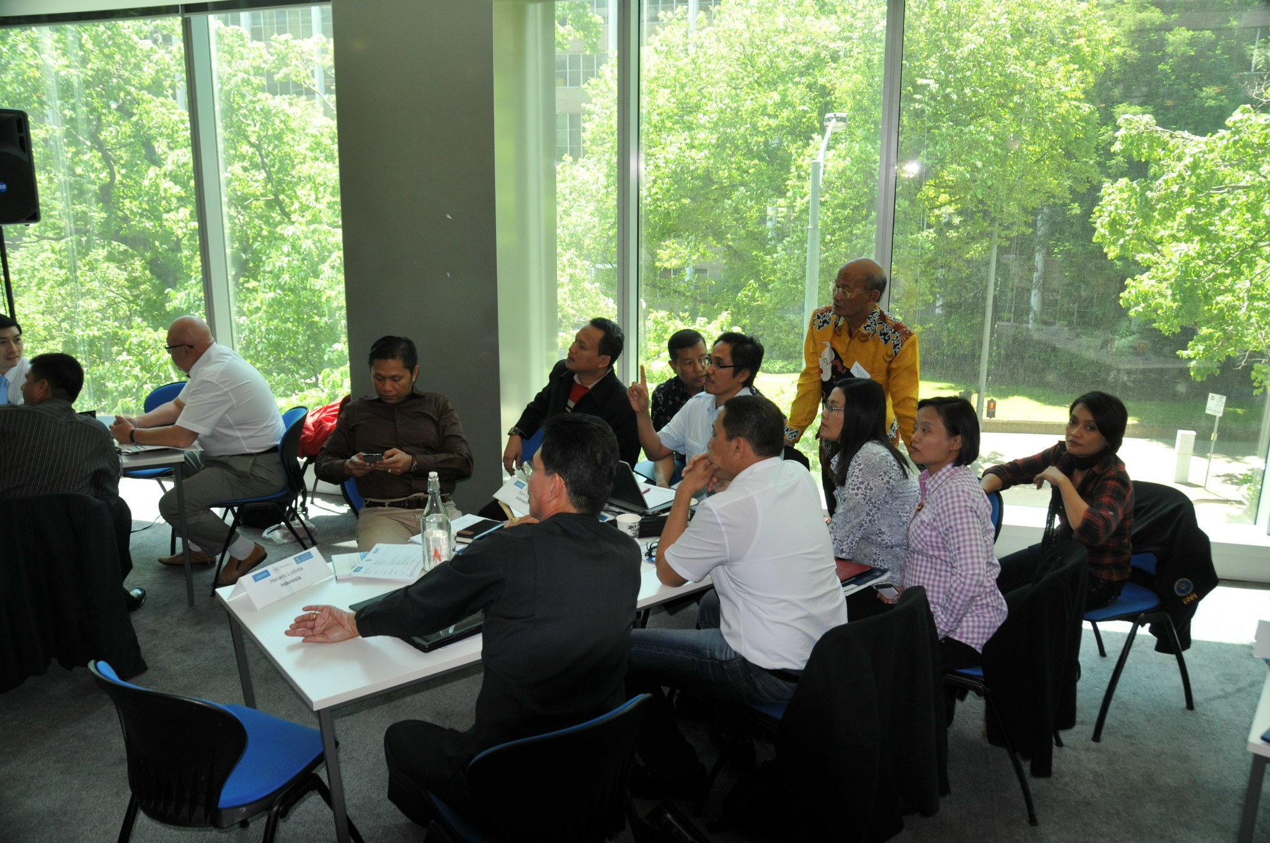
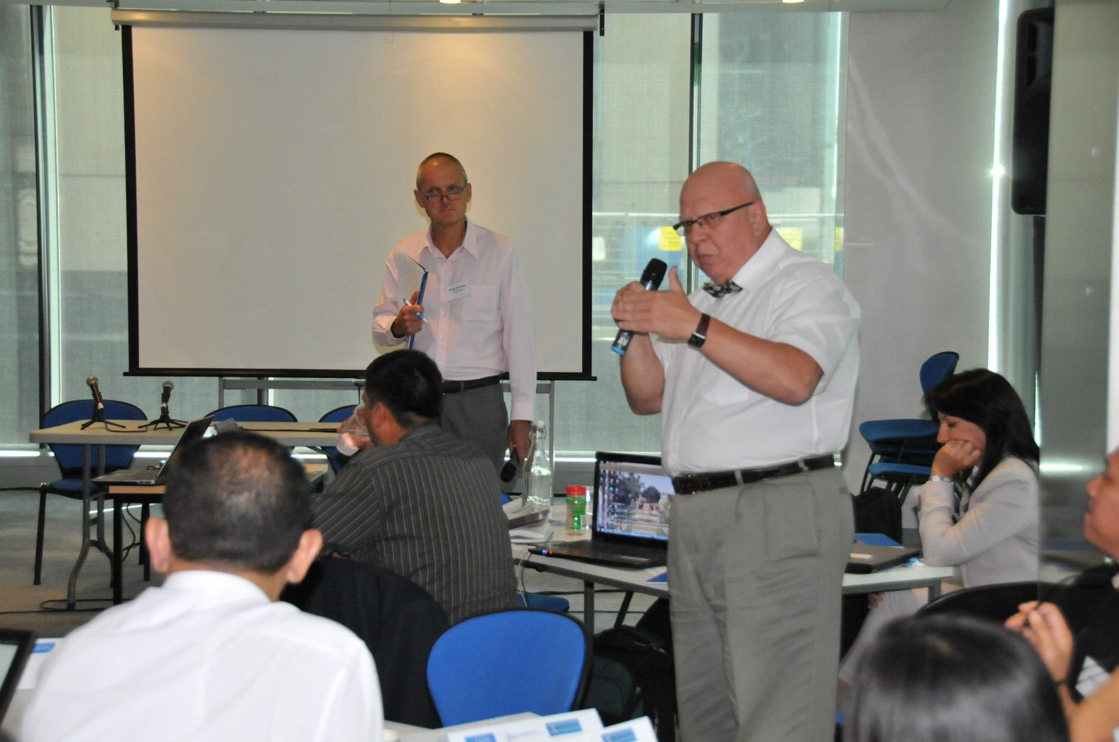
LEAHN Consultation 2012 Melbourne
.

Slide 3
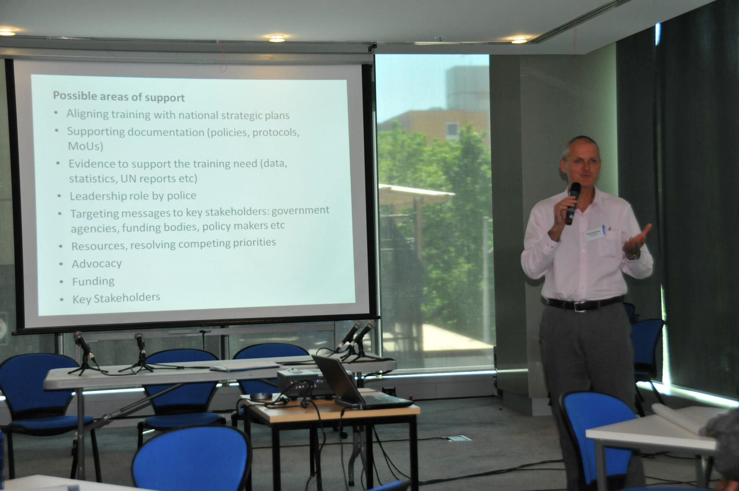
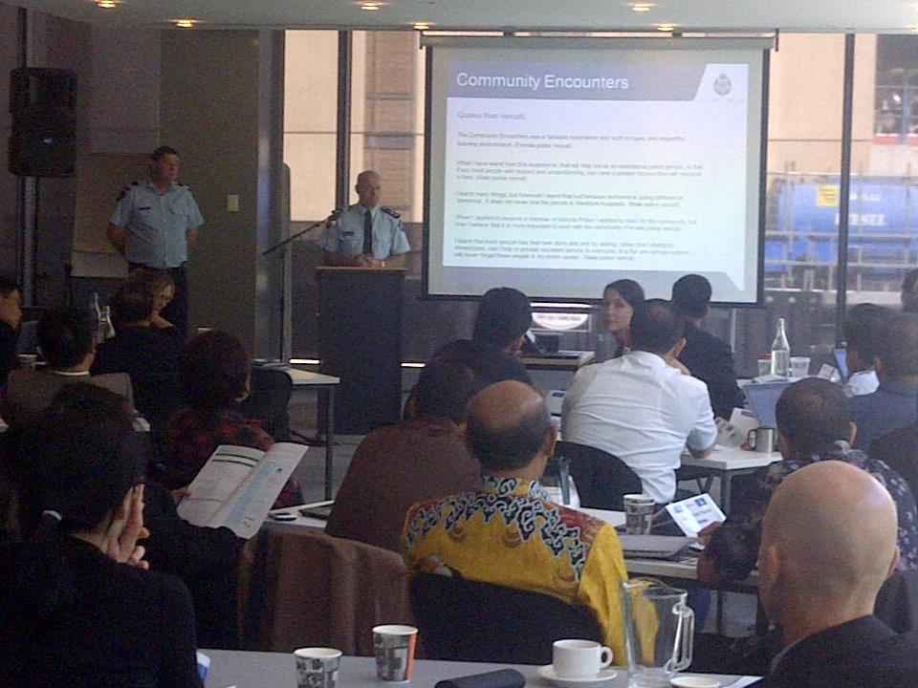
LEAHN Consultation 2012 Melbourne
.

Slide 4
LEAHN Consultation 2014 Amsterdam
.

Slide 5
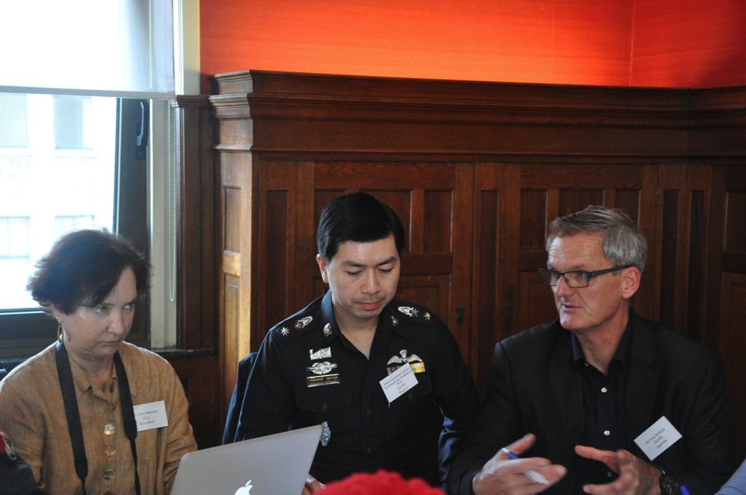
LEAHN Consultation 2014 Amsterdam
.

Slide 6
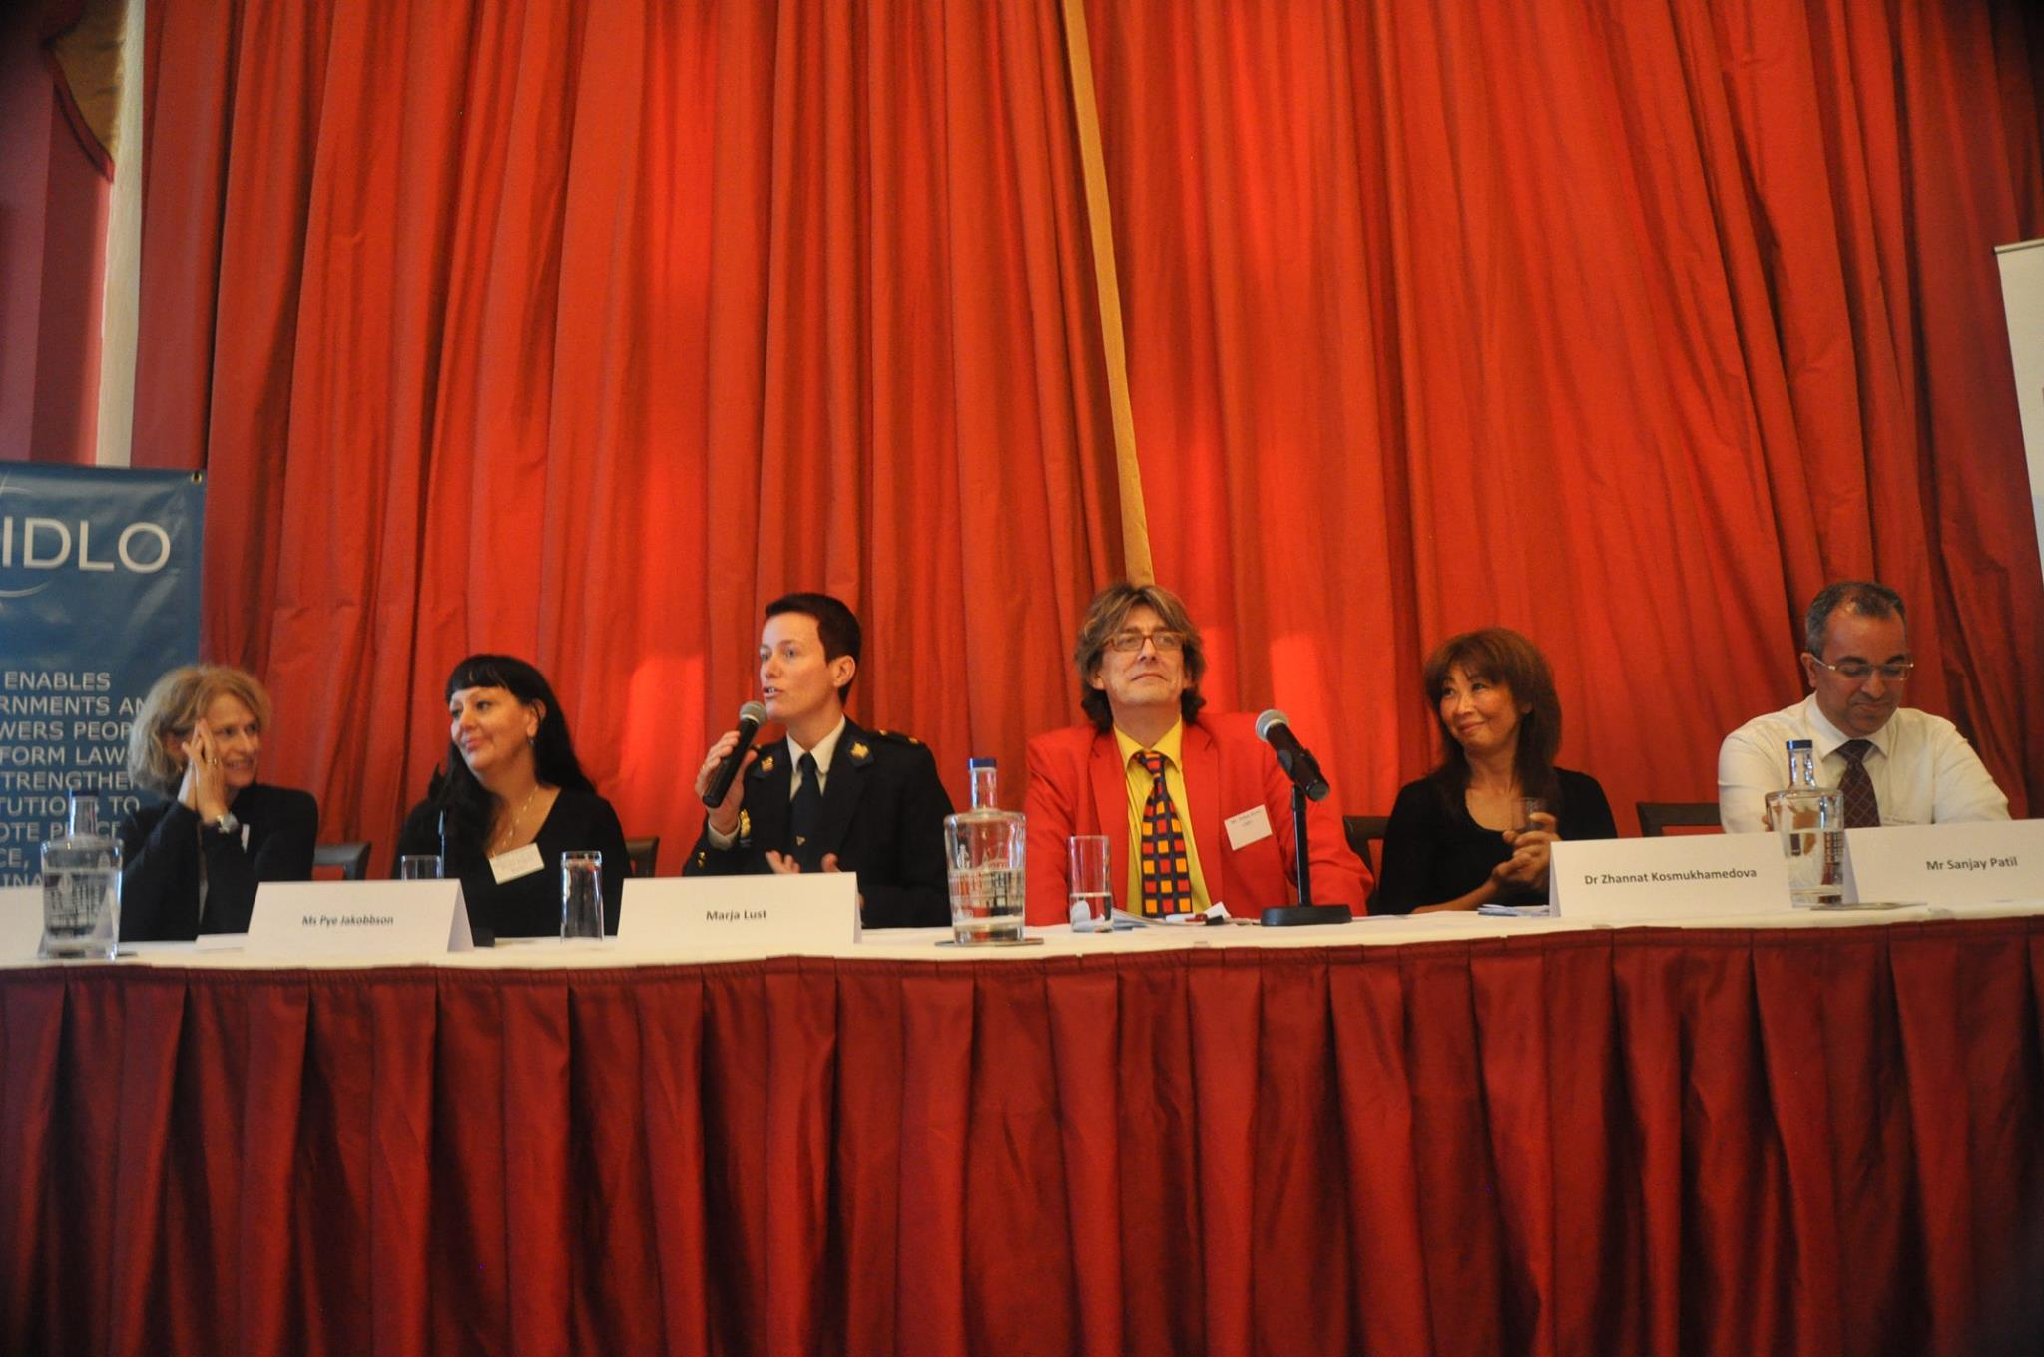
LEAHN Consultation 2014 Amsterdam
.

Slide 7
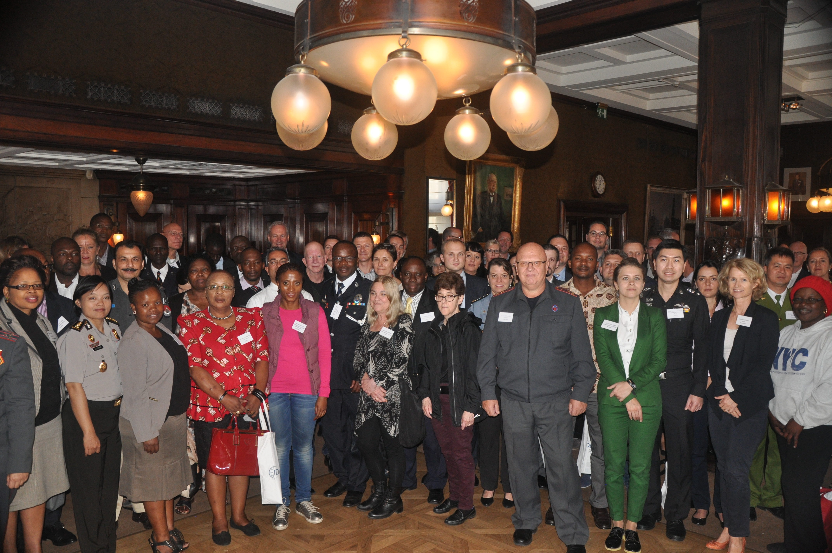
LEAHN Consultation 2014 Amsterdam
.

Slide 8
LEAHN Consultation 2014 Amsterdam
.

Slide 9
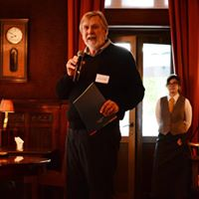
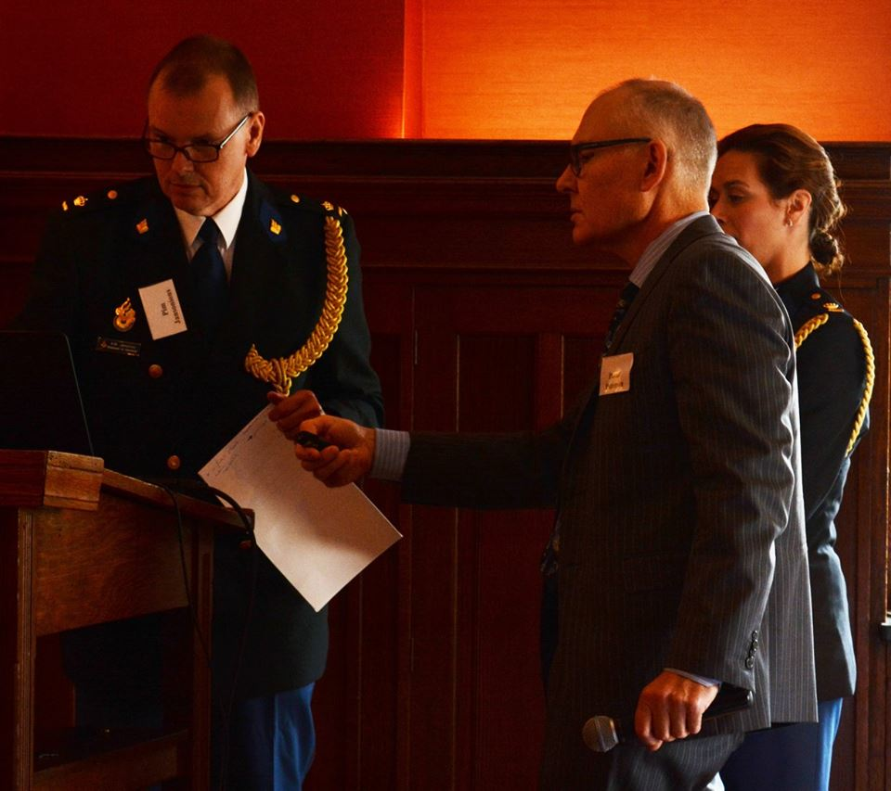
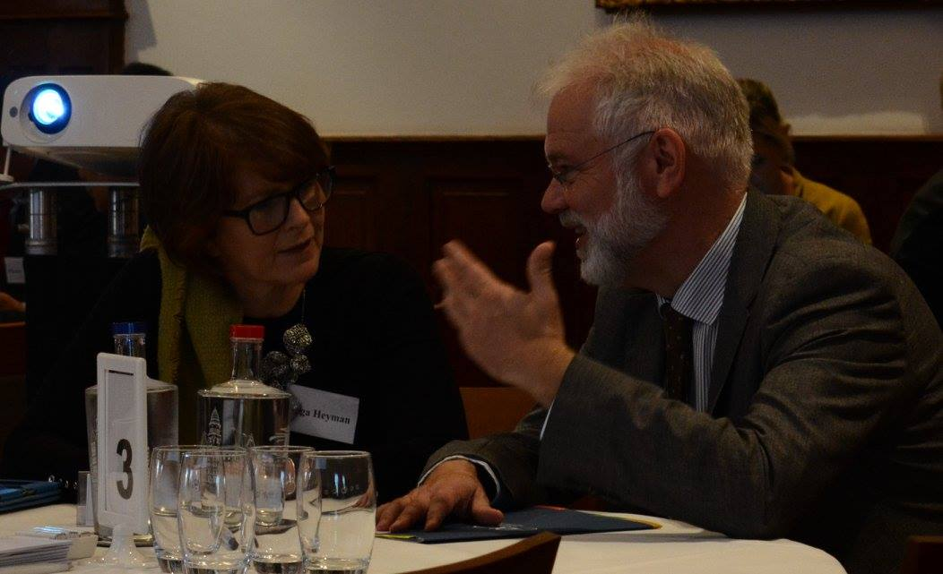
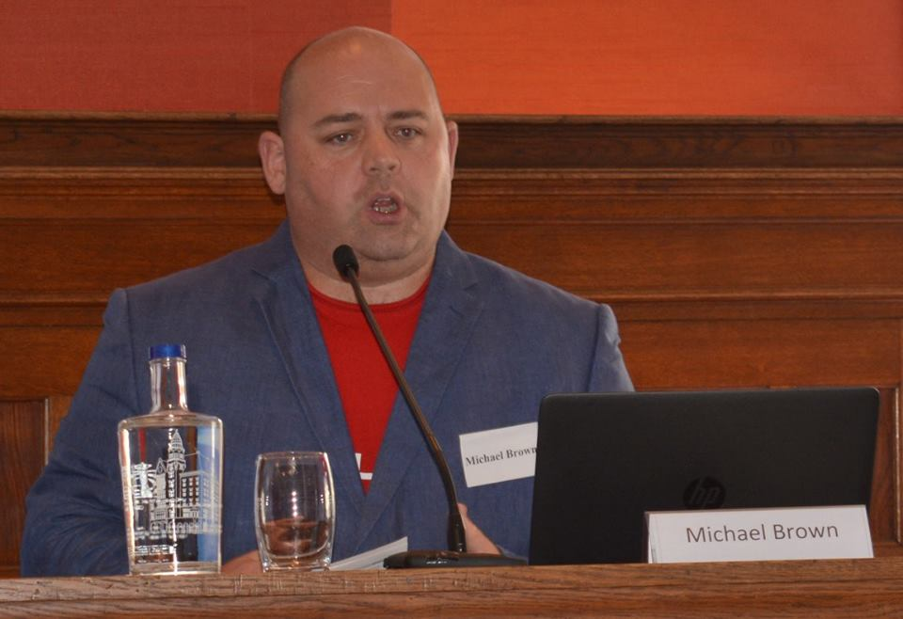
LEAHN Consultation 2016 Amsterdam
.

Slide 10
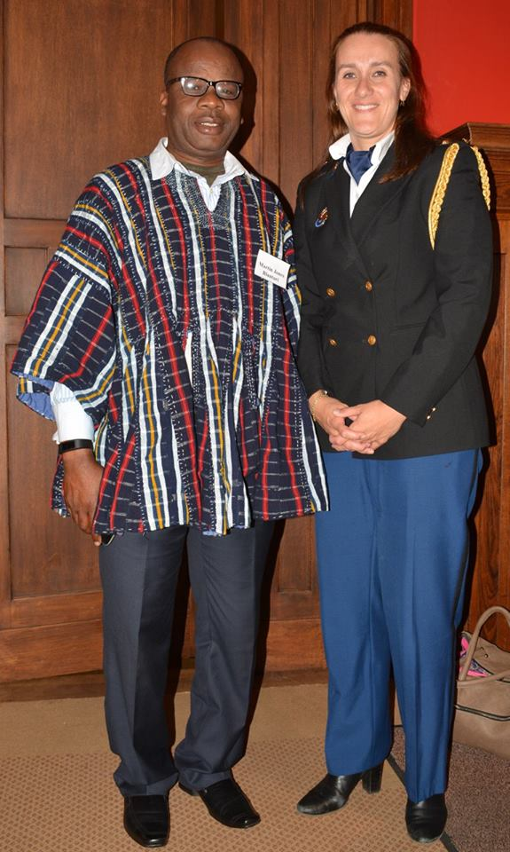
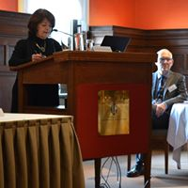
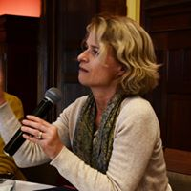
LEAHN Consultation 2016 Amsterdam
.

Slide 11
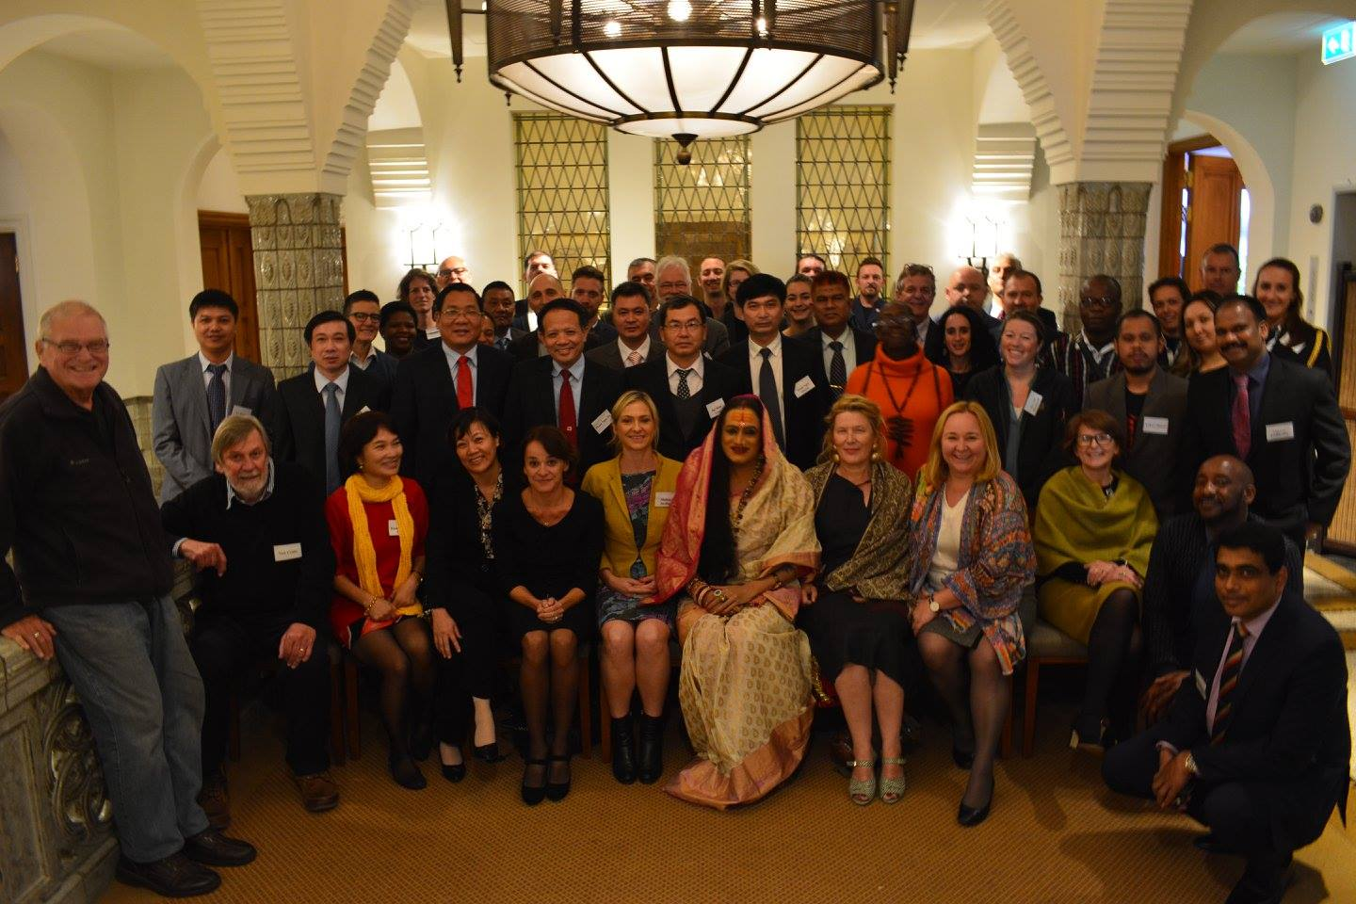
LEAHN Consultation 2016 Amsterdam
.

Slide 12
Further information can be obtained from:
LEAHN website: www.leahn.org
@LEAHNetwork
CLEPH website: www.cleph.org.au
@CLEPH

